Slide 1
System Operation European Stakeholder Committee
Materials for meeting 22 Sept 2022

Slide 2
Agenda
Topic | Timing | Presenter
1. Opening Review of the agenda Review and approval of minutes from previous meeting Review of actions | 08.00 - 08.15 | ACER, Uros Gabrijel ENTSO-E, Cherry Yuen
2. Update on the implementation actions at pan-EU level | 08.15 - 08.30 | ENTSO-E, Cherry Yuen
3. Cybersecurity Network Code – Status update | 08.30 - 08.45 | EC, TBD
4. Report on CGM Implementation – transition go-live to implementation | 08.45 - 09.00 | ENTSO-E, Jonathan Boyer
5. Resilience of the EU generation infrastructure to weather-related hazards | 09.00 - 09.15 | ACER
6. High-level update on synchronisation of Ukraine | 09.15 - 09.30 | ENTSO-E, Walter Sattinger
7. BREAK | 09.30 - 09.40
8. KORRR amendments | 09.40 – 10.00 | Cherry Yuen
9. SO GL ACER implementation monitoring report in SO GL and data exchange ENTSO-E comments | 10.00-10.15 | ACER ENTSO-E/Cherry Yuen, Victor Charbonnier
10. Update on Tmin FCR LER | 10.15-10.25 | ACER (ENTSO-E, Luca Ortolano)
11. AOB | 10.25 - 11.00

Slide 3
1. Review of actions
ENTSO-E, Cherry Yuen

Slide 4
1 Review of actions SO ESC
ACTION | ANSWER | STATUS
Deterministic Frequency Deviation: 1) Could a reporting regarding the actions taken by TSOs to deal with deterministic frequency deviations (DFD) be put in place with market participants ? 2) What is the status of new frequency quality criteria in SAFA as well as the implementation of mitigation measures? | "ENTSO-E will share the list of DFD mitigation measures, which has been shared with SO CG in August 2021, with SO ESC; Update: the slide deck was shared after the meeting. The target parameters in Policy LFC&R B-1-2 are amended each year. These values are part of the public part of SAFA which is published here on the EE website“ | Ongoing -> Done
Invite stakeholders | ENTSO-E will check if COGEN (Gunnar Kaestle) and other stakeholders (e.g. WindEurope) can be invited as guest to the internal group within ENTSO-E in charge of analysis the ‘’wind eclipse’’. Update: the analysis is postponed due to the emergency synchronisation project. | Ongoing

Slide 5
1 Review of actions SO ESC
ACTION | ANSWER | STATUS
NC/GL Amendments: EC to inform about their planning and stakeholder involvement on SO ESC September meetings for updates in SO GL | Pending answer from EC | Ongoing
Administrative: ENTSO-E secretariat shall update the website |  | Ongoing
Administrative: All organisations are asked to update their list of members and respecting the number of seats dedicated to each organisation before the next ESC meeting | ENTSO-E send individual emails to facilitate the work | Ongoing

Slide 6
Stakeholder’s feedback on agenda
Topic 5. Resilience of EU generation infrastructure to weather-related hazards.
The 2021 "Texas Freeze" and also the collapse of a German 110 kV transmission line in 2005 because of wet freezing snow is certainly a weather hazard. But what is with the more long term effects, which go hand in hand with the power adequacy question regarding long term storage.
Example: hot weather in summer for a longer time drives AC consumption up, not only in peak terms but also in energy terms. Rivers are not suited as terminal heat sink and thermal power plants have to be restricted in their output power. Hydropower reservoirs are not refilled in a draught and enhance the need to burn more gas. This may lead to tight natgas situation (= long term storage) if the winter is long and cold and may endanger system adequacy.
Finngrid warning weather related? Other TSOs face a similar situation (but haven't communicated that directly) ?
https://www.fingrid.fi/en/news/news/2022/several-uncertainties-in-the-adequacy-of-electricity-in-the-coming-winter--finns-should-be-prepared-for-possible-power-outages-caused-by-electricity-shortages/
Topic 6. High-level update on synchronisation of Ukraine
At the last meeting it was mentioned that the future synchronisation of the Baltic grids prior to the agreed roadmap is probably difficult, not because of a lack of energy, but due to stability issues which could lead to frequent frequency collapses.
How far could microgrid technology help to solve the stability issue, meaning self-regulation of dispatchable loads?
How many cars with a P(f) sensitive on-board charger would be needed to give enough stability margin to the grids of Estonia, Latvia and Lithuania? (cf. Attachment: Self-Regulation of Dispatchable Loads in Resilient Power Systems)
Topic 10. Update on Tmin FCR LER
Primary control (FCR) has 30 s to ramp up, secondary control (aFRR) 5 min and tertiary control (mFRR) up to 15 min
Why a double hump curve FCR with 15 min each is not sufficient? If we are afraid that the tertiary reserve is not reliably available, we should just allow TSOs to contract more mFRR to compensate the gap statistically. This seems to be cheaper than making FCR more costly. Primary control market is dominated by battery storages (at least in DE), simply because they have lower overall costs than thermal power plants running in part load with .
https://www.regelleistung-online.de/batteriespeicher-2022-starkes-wachstum-in-der-prl-erwartet/

Slide 7
2. Update on the Implementation Actions
ENTSO-E, Cherry Yuen

Slide 8
Pan-European or regional deliverables 2022: SOGL/NCER
Secure data collection and validation platform being set up for the PRA (Probabilistic Risk Assessment) methodology expected in 2027
– procurement process for data collection tool ongoing
Ukraine/Moldova:
Updates to be provided in dedicated agenda item #6
CSAm
(Article 44.5)
Operational Agreements

Slide 9
Pan-European or regional deliverables 2022: SOGL/NCER
Analysis completed on SO GL data exchange framework, taking into account regulatory changes
Related SO GL amendments on data exchange submitted to EC public consultation for CACM 2.0 amendments
Details to be presented in today ESC meeting in agenda item #8
ACER has published an SO GL Implementation Monitoring report, focusing on data exchange provisions, which is available here
The ENTSO-E data exchange expert team has provided inputs for ACER consideration
Details on ENTSO-E inputs to be presented in agenda item #9
KORRR
SO GL Implementation Monitoring

Slide 10
Pan-European or regional deliverables 2022: SOGL/NCER
SO GL Implementation – art. 15
ENTSO-E to publish annual report on Incidents Classification Scale (ICS) end September 2022
ENTSO-E to publish annual report on Load-Frequency Control (LFC) end September 2022
ENTSO-E to publish annual report on Regional Coordination Assessment end September 2022
SO GL Implementation – art. 16
SO GL Implementation – art. 17

Slide 11
3. Cybersecurity Network Code – Status update
EC

Slide 12
4. Report on CGM Implementation
ENTSO-E, Jonathan Boyer

Slide 13
Enabling reliable and efficient grid operations via regional coordination
What: Identify risks to operational security in the vicinity of borders and identify efficient remedial actions as recommendations to affected TSOs
What: Consistent pan-European grid model, providing an hourly view of grid assets (generation, consumption, transmission)
Benefits: Identification of operational security risks across all participating TSOs and identification of the most efficient remedial
Risk identification: operational security risk notification
Efficiency: identification of efficient and cost effective remedial actions
Benefits: single, consistent grid model per time stamp across all affected TSO jurisdictions – a critical input to accurate outcomes from the other RSC services
Consistency: consistent, single, transparent grid models
Common Grid Model
(CGM)
5 services to TSO for EU system security, market & RES integration
Security analysis
(CSA)
Outage coordination
(OPC)
What: single register of planned outages for grid assets and coordinated collaboration with respect to implications and options for outages
Benefits: Systematic and coordinated approach to outages, enabling:
Efficiency: optimised maintenance of outages across borders
Transparency: identification of issues caused by incompatible outages
Capacity calculation
(CCC)
Adequacy forecast
(STA)
What: calculation of available electricity transfer capacity across borders (either flow-based or net transfer capacity methodologies
What: forecast adequacy and remedial actions
Benefits: Consideration of full grid =
Accuracy: more accurate calculation of available cross-border capacity
Efficiency: more efficient utilisation of available capacity
Responsiveness: greater responsiveness to system conditions
Benefits: pan-EU view of adequacy and available remedial actions:
Early warning: reducing risks of serious grid disruption
Consistency: single view of adequacy for TSOs, avoiding bilateral engagement with other TSOs

Slide 14
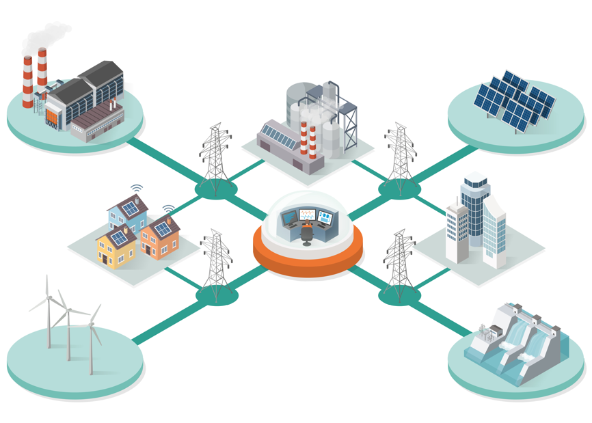
Importance of CGM and OPDE to facilitate coordinated services
IGMs/ CGMs are critical inputs to other RSC Services
OPDE is SOGL-mandated platform for the exchange of all relevant data for these services
CGM and OPDE are therefore the basic enablers for reliable Grid Operations
Grid Operations relies on Cross-border Operational Planning
Coordinated Security Analysis (CSA)
Coordinated Capacity Calculation (CC)
Outage Planning Coordination
(OPC)
Short and Medium Term Adequacy
(STA)
Regional coordination processes
ENABLED BY
Common and shared planning data
Common Grid Model (CGM)
SHARED AND ACCESSED THROUGH
Digital infrastructure for pan-European data exchange & storage
Operational Planning Data Environment (OPDE)

Slide 15
Overview of CGM build process
The CGM build process produces a consistent pan-European grid model, rely on the data exchange network and applications within OPDE
TSO
OPDE
RSC
Y-1, D-2 timeframes
For all timeframes where market trading has not occurred, D-2 & earlier
CGMA application/process determines cross border schedules/AC net positions
Used an input to IGMs for corresponding timeframes
PPD determine / submit
CGMA initial optimisation
CGMA initial schedule
PSLCD submission
CGMA final optimisation
CGMA final schedule
All timeframes (Y-1, D-2, D-1, ID)
IGM build / validate / submit
IGM manage / store / distribute
EMF quality checks
TSOs generate/submit IGMs to OPDE
OPDE manages IGM storage/distribution
RSCs receive IGMs, merge to create CGMs and submit to OPDE
OPDE manages CGM storage/distribution
RSC services access CGMs from OPDE
Outage Planning Coordination (OPC)
CGM manage / store / distribute
CGM merge / publish
Coordinated Capacity Calculation (CCC)
Common Grid Model
D-1, ID timeframes only
Short Term Adequacy (STA)
For all timeframes where market trading has completed, D-1 & Intraday
PEVF application/process determines cross border schedules/AC net positions
Used an input to IGMs for corresponding timeframes
PEVF data determine / submit
Verification / alignment
PEVF schedule
Coordinated Security Analysis (CSA)

Slide 16
Priority Focus Areas for 2022
Increased transparency to all OPDE users
Automation of rotational calendar
Automated marking of Main/Backup CGMs
Automated Article 17 reporting
Key data exchanges for OPC, STA, CSA – ready for when RSC services commence service trialling
CGM Rotational Principle
OPC, STA, CSA
W-1 CGM build processes (D3 to D7) required for OPC/STA
Mandated extension of intraday process to operate hourly (for remaining hours in day, instead of current 3 times per day), to support CSA service
W-1 Build Process
Extension to Intraday
Single consistent validation Ruleset Library (RSL), automatically installed locally
Enforcing official publishers of RSLs
Transparency of validation/RSL versions in OPDM Client
Various performance improvements to validations, facilitating alignment with mandated process times
File/Model Validation
Central Authentication Solution
Greater efficiency for all OPDE Users, enabling integrate of local authentication solutions with OPDM Client for user management (reducing process overheads)
Greater efficiency via central authentication service for central portal access (avoiding access management by portal)
Technical / Security
Provision to SIEM solution (security monitoring) of all required logging data
Other technical/security issues or deferred MVS items
Notes:
These approved priority focus areas are a key input to decisions per governance, project planning, delivery planning, vendor contracting, detailed design, build, testing and rollout.
CGM Rotational Principle enables a minimum of two RSCs/RCCs to participate in the CGM creation process and it is based on SOC decision from 2019.
Changes related to Week-1 Build process are being developed to facilitate the “Week Ahead” timeframes required by two RSC services: Outage Planning Coordination (OPC) and Short-Term Adequacy (STA).
Extended intraday process for RSC/RCC services to execute the security analysis is targeted in regional methodologies, with at least three intraday timeframes in accordance with CSA Methodology (Art 24). The need for a more frequent intraday CGM building process covering all remaining hours of the day is considered as a requirement for purposes of some Regional CSA process (Art 4 in Core ROSC Methodology, Art 18 in Italy North ROSC Methodology, SEE ROSC Methodology).
Some of the change requests that are approved within Priority Focus Areas will be part of the next release that will happen during the summer 2022.

Slide 17
Priority Focus Areas for 2023
Priority technical/security improvements to facilitate robustness and compliance
Various identified enhancements to PEVF operation, to facilitate more efficient/effective process
Technical / Security
PEVF Operation
Changes to CGM/OPDE to facilitate W-1 CGM build process (for D-3 to D-7 with selected applicable timestamps)
Various identified enhancements to QAS operation, to facilitate more efficient/effective process
W-1 CGM Build Process
QAS
Operation
Efficiency and performance improvements in management of Ruleset Library/Validation Module
Extension of the 2022-delivered OPDE Archive solution to facilitate ACER data provision requirements (per SOC data task force)
File/Model Validation
OPDE Archive
Provision of single source of Master Data (in a defined format) for use in all OPDE applications
BMA/Master data
STA
Changes to OPDE to facilitate use of CGM in STA processes and relevant data exchanges via OPDE
Changes to OPDE to facilitate use of CGM in CSA processes and relevant data exchanges via OPDE
CSA
Intraday Extension
Changes to CGM/OPDE to facilitate required increase in intraday CGM build process (to run hourly for the remaining hours in the day, for CSA process)
OPC
CCC
Changes to OPDE to facilitate use of CGM in OPC processes and relevant data exchanges via OPDE
Changes to OPDE to facilitate use of CGM in CCC processes (where applicable) and relevant data exchanges via OPDE

Slide 18
Regional Coordination
Key factors for migration of RCC services
CGM Individual Readiness Status
Implementing additional timeframes (i.e., W-1, M-1) for RSC Services / RCC Tasks
Requirements arising from regional methodologies
Harmonized migration planning between different regions and services / tasks
Key activities for harmonized migration planning in 2022 and 2023
Strategic roadmap for alignment relating to data exchange via OPDE
Overall objectives:
Develop a “target architecture” against which each service (existing and new) can develop a cost-benefit change/implementation plan
Facilitate efficient implementation of regulations and realize business processes in challenging delivery timescales (e.g. ROSC in 2024-5)
Implement regional services in a consistent way with European and national requirements​
Enable efficient alignment of services with the mandated use of OPDE for data exchanges and storage, and the use of standard-compliant models in business processes and according to business needs
Integrated Roadmap
Overall objectives:
A summary of the regional and cross-regional plans for use of CGMs in RCC (RSC) services and data exchange via OPDE, critically important for:
Transparency
Delivery planning
Community-wide commitment to ongoing efforts
Reporting
CGM/OPDE development
Overall objectives:
The prioritisation and delivery of changes to CGM/OPDE, in order to:
Facilitate migration of RCC (RSC) services
Improve the efficiency or effectiveness of CGM/OPDE services

Slide 19
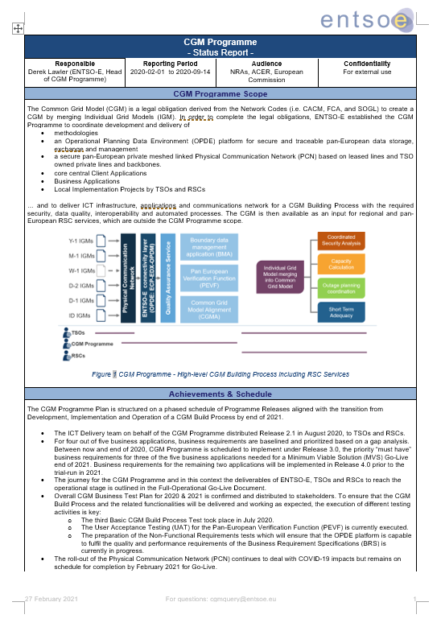
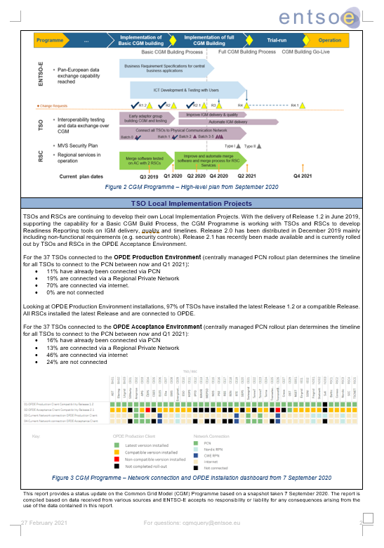
Regular reporting
Next report for SO CG is planned for December 2022
First annual report on regional coordination assessment (according to Article 17 SOGL) covering the CGM Business Process will be published in 2023 covering the service operation in 2022.
+

Slide 20
Questions?

Slide 21
5. Resilience of the EU generation infrastructure to weather-related hazards
ACER

Slide 22
6. High-level update on synchronisation of Ukraine
ENTSO-E, Walter Sattinger

Slide 23
UA/MD - Commercial exchanges timeline
28 July 2022 - RGCE extraordinary meeting
Approved to increase immediately to 250 MW and review again the maximum capacity on 2nd of September RGCE extraordinary meeting
27 June 2022
TF confirmed that the preconditions were met and commercial exchanges with Ukraine can start
2nd September 2022
RG CE extraordinary meeting
Approved to maintain 250 MW during the low load hours and to increase to 300 in high load hours and review again the maximum capacity on 20nd of September RGCE meeting
30 June 2022
100 MW export begun – daily auctions with Romania and Slovakia
System security and stability continuously monitored during 4 weeks
7 June 2022
ENTSOE / RG CE approved the preconditions and process to allow a stepwise increase of the commercial exchanges

Slide 24
7. BREAK

Slide 25
8. KORRR amendments
ENTSO-E, Cherry Yuen

Slide 26
KORRR methodology and related SO GL amendments
SO ESC meeting, 22nd Sept 2022
Cherry Yuen

Slide 27
KORRR Methodology review – project background (1/2)
On 1st of December 2021, the ENTSO-E System Operation Committee (SOC), at its meeting in Paris (France) approved the Project Initiation Document (PID) mandating the Steering Group Operational Framework (StG OF) to review the existing SO GL data exchange methodology and framework.
It was decided to conduct an analysis to determine if, and what, amendments might be needed to the SO GL methodology KORRR and the related requirements on data exchange in the SO GL.
Project triggers
Amendments on CACM GL:
GLDPM is removed creating a possible gap on data required for individual grid model preparation, new requirements for type A generators
Joint TSO-DSO Roadmap on Demand Side Flexibility:
Request for disaggregation of aggregated data (for congestion management purposes), treatment of non-significant grid users
Standardisation:
WindEurope request to streamline data exchange requirements across Member States e.g., by implementing certain standards

Slide 28
KORRR Methodology review – project background (2/2)
Completed
Completed
Completed
In progress
Task 1
Organise call for nominate to gather TSO experts in a Joint Task Force between Steering Group Operational Frameworks and Steering Group Strategy
Task 2
Review gaps in the existing regulatory framework
Task 3
Develop amendments proposals and propose a stakeholders’ engagement plan when necessary (e.g., discussion with DSOs on provisions involving them)
Task 4
Lead discussion with relevant stakeholders (bilateral meetings, dedicated workshops, SO ESC, SO CG)
Project description
Consolidate findings from relevant discussion (CACM GL and EG DSF) and desirable improvements to SO GL and KORRR Methodology
Assess the risk and benefits with these changes
Identify relevant provisions in SO GL and KORRR methodology to evolve as a consequence
Identify risk of inconsistencies between existing and new requirements in SO GL or with other regulation
KORRR: Key Organisational Requirements, Roles and Responsibilities relating to Data Exchange;
CACM GL: Capacity Allocation and Congestion Management Guideline;
EG DSF: SO ESC Expert Group on Demand Side Flexibility

Slide 29
SOC decisions at their 70th meeting on Apr 27th

Slide 30
Proposed amendments to the KORRR Methodology
Editorial
DSF triggered
CACM 2.0 triggered
 | Amendment number | Amendment proposal
1 | Amendment 1 – General amendments | Title change for KORRR removing words “All TSOs’ proposal for the” and updating references of the Electricity Regulation and Electricity Directive to regulations and directives that are currently in force.
2 | Amendment 2 – Whereas section | Additional provision in the “Whereas” section on individual devices to be used for sending a real-time data. The national framework applied by TSOs and DSOs should clarify the required accuracy of the real time data, may it be individual tele-measurement or individual device providing aggregated data.
3 | Amendment 3 – Whereas section | Proposal to remove KORRR whereas recital number (2).
4 | Amendment 4 – Art. 3, General Responsibilities | Proposed amendment to the Article 3 “General Responsibilities” to complement it by mirroring requirements to ensure data providers fulfil DSOs needs even in the case where TSO is the primary receiver of aggregated data.
5 | Amendment 5 - Art. 10, Provisions of Real-Time Information | Each TSO shall define the refresh rate for the real-time data exchanges in its control area. It shall not be longer than 1 minute. The refresh rate shall take into consideration the requirements associated to the different system services and operational security requirements for which data exchange is required needed and requested”
6 | Amendment 6 - Art. 12, Rights and responsibilities of DSOs | Include the provision of topological remedial actions, topological agreed measures and best forecast operational topological situation in Article 12 of KORRR.

Slide 31
8. SO GL data exchange requirements - potential amendments
ENTSO-E, Cherry Yuen

Slide 32
SO GL amendments

Slide 33
SO GL amendment proposals on data exchange
ACER’s recommendation repeal Generation and Load Data Provision Methodology
CACM today
Revised CACM
Removal of provisions related to GLDPM:
ACER recommends to integrate Article 16 of the current CACM Regulation into Title 2 in the SO Regulation by expanding these provisions to include also the data required for the creation of individual and common grid models for capacity calculation.
Article 16:
Generation and load data provision methodology
TSOs identify gaps comparing the current requirements in GLDPM and the amendments recommended for SO GL. TSOs propose the following amendments to solve these gaps and keep the current data exchange requirements enforced.
Article SO GL | Amendment proposal
Art. 43, Structural data exchange | Include a new point in article 43.3 for the provision of operational monitoring limits for relevant grid elements. Also, include in Art. 43(5) the provision of the total aggregated generating capacity of the type A power generating modules per connection point, not only per primary energy source.
Art. 44, Real-time data exchange | Include in Art. 44(e) the provision of control settings of regulating equipment where relevant.
Art. 47, Real-time data exchange | Include in Art. 47 a new point 1(d) in order to cover the provision of the type of control mode of power generating modules.

Slide 34
Proposed changes to System Operation Guideline (SO GL) –
StG OF to take care of
DSF triggered
CACM 2.0 triggered
 | Amendment number | Amendment proposal
1 | Amendment 1 – SO GL Art. 40(10), Organisation, roles, responsibilities, and quality of data exchange | Adding the following wording to the provision 10 of the Article 40: “and other DSOs as applicable” in order to include also DSOs that do not have a connection point with transmission network.
2 | Amendment 2 – SO GL Art. 43, Structural data exchange | Including a new point in article 43.3 for the provision of operational monitoring limits for relevant grid elements. Also, including in Art. 43(5) the provision of the total aggregated generating capacity of the type A power generating modules per connection point, not only per primary energy source.
3 | Amendment 3 – SO GL Art. 44, Real-time data exchange | Include in Art. 44(e) the provision of control settings of regulating equipment where relevant.
4 | Amendment 4 – SO GL Art. 47, Real-time data exchange | Include in Art. 47 a new point 1(d) in order to cover the provision of the type of control mode of power generating modules.

Slide 35
Other possible SO GL amendments
Identified errors (also NC ER)
CEP impact (also NC ER)
Pan-European SO GL methodologies (CACM 2.0 amendments):
KORRR – amendments identified (presented)
CGMM – small or no amendments (tbd)
CSAm – possibly no amendments (tbd)
Asset relevance for outage coordination methodology – possibly no amendments (tbd)
Interdependence with other GLs/NCs (CACM, CNC, etc.) should be carefully considered to ensure consistency and to avoid any regulatory gaps before amendments consolidation
Amendment process for methodologies can be triggered by TSOs but for NC/GL it should be triggered/aligned with ACER & the EC

Slide 36
Other issues observed

Slide 37
Other issues to be addressed differently (e.g., at national level)
 | Identified issue | Issue
1 | EU framework to entitle right for TSOs/DSOs to ask for additional data as needed | DSOs and TSOs may have demonstrated and justified needs for additional requirements to SO GL data exchange framework (e.g., to type A units not engaged as ancillary service providers by means of aggregation), it is the TF understanding that Member States (MS) are entitled to specify additional requirements as national requirements. This is based on the subsidiarity principle that applies in the Union.
2 | ENTSO-E to engage with standardisation bodies and stakeholders for promoting joint work on relevant standards | Initiate discussions within ENTSO-E to engage with standardisation bodies and stakeholders in joint work on relevant standards

Slide 38
10. Update on Tmin FCR LER
ENTSO-E, Luca Ortolano

Slide 39
Ongoing and future activities
Identification and analyses of the long-lasting frequency deviation events:
CE frequency deviation in 2017-2021 interval are scanned to identify the most challenging LLs.
The identified events are investigated in order to understand their root causes
Only the most impacting LL deviations are considered
Assessment of the potential impact of such events on the system, considering the presence of LER

Slide 40
Next Steps

Slide 41
TSOs work schedule
The activities to be performed can be summarized and scheduled as follows:
Identify the relevant LL events to be investigated and continue the root causes analyses
*Only 6 events out of 20 were already investigated since they triggered the criteria for activating a specific study among ENTSO-E TSOs.
For the other events it takes more time to analyze them into detail.
All relevant LLs in ‘17-’21 interval are identified
The root causes investigations continue.
Finalization of the LLEFD analysis on the root causes
For all the relevant LLs the root causes are understood*.
Identify the effect of mitigation actions on LLs.
For each LL, is investigated how the existing mitigation actions would have effected the df.
Conclusion
Final considerations are drawn;
Suitable «smoothing factors» are applied to LLEFDs if relevant.
05/2022
Early October
End of October
Current work in progress

Slide 42
Thank you for your time

